Slide 1
Design and Analysis of Algorithm
UNIT-II
Greedy Algorithm
M Yogi Reddy
Assistant Professor,
Dept. of CSE,
School Of Technology,
GITAM(Deemed to be ) University,
Hyderabad.

Slide 2

Contents
Greedy Algorithm- General method
How greedy algorithm work
Characteristics of greedy algorithm
1
2
3

Slide 3
Recap
Approach to design algorithm
Divide and conquer
Greedy
Dynamic
Backtracking

Slide 4
Greedy Algorithm
An algorithm that at every step selects the best choice available at that time without regard to possible future consequences.
The greedy method is applied to a wide variety of optimization problems where the problem have $n$ inputs and require us to obtain a subset that satisfies some constraints.
The greedy method is applied to a wide variety of optimization problems where the problem have 𝑛 inputs and require us to obtain a subset that satisfies some constraints.
Any subset that satisfies those constraints is called a feasible solution.
We need to find a feasible solution that either maximizes or minimizes a given objective function.
A feasible solution that does this is called an optimal solution.

Slide 5
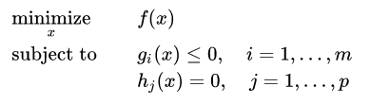
Optimization Problem
An optimization problem is the one where the goal is to find the best solution from all feasible solution
These problems appear with an objective function such as:
Maximize profit
Minimize risk
is the objective function to be minimized
are called inequality constraint
are called equality constraint

Slide 6
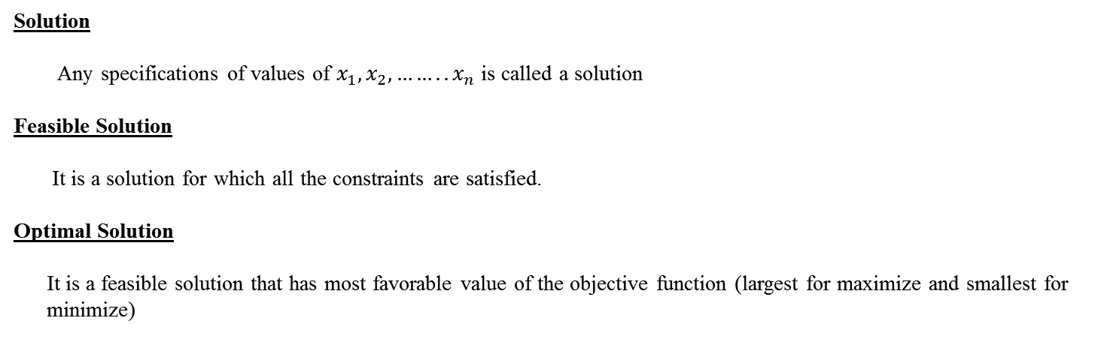
Solution
Solution
Any specifications of values of $x_{1}, x_{2},……..x_{n}$ is called a solution
Feasible Solution
It is a solution for which all the constraints are satisfied.
Optimal Solution
It is a feasible solution that has most favorable value of the objective function (largest for maximize and smallest for
minimize)

Slide 7
Solving optimization problem
For most optimization problems we want to find, not just a solution, but the best solution.
A greedy algorithm sometimes works well for optimization problems. It works in phases. At each phase:
You take the best you can get right now, without regard for future consequences.
You hope that by choosing a local optimum at each step, you will end up at a global optimum

Slide 8
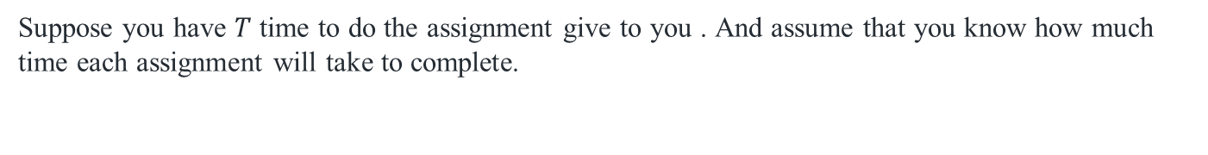
How Greedy Algorithm works
Suppose you have $T$ time to do the assignment give to you . And assume that you know how much time each assignment will take to complete.
Objective Function
What you want ?
Complete maximum assignment to get better marks
Constraint
What is restricting you from completing all the assignment?
Time limit
This is a simple Greedy-algorithm problem. In each iteration, you have to greedily select the assignment which will take the minimum amount of time to complete.

Slide 9
How Greedy Algorithm works
Let A = {5, 2, 1, 3, 4} and T = 6
$1^{st} Choice$
Assignment 3
Assignment completed 1 Time remaining 5
$2^{nd} Choice$
Assignment 2
Assignment completed 2 Time remaining 3
$3^{rd} Choice$
Assignment 4
Assignment completed 3 Time remaining 0

Slide 10
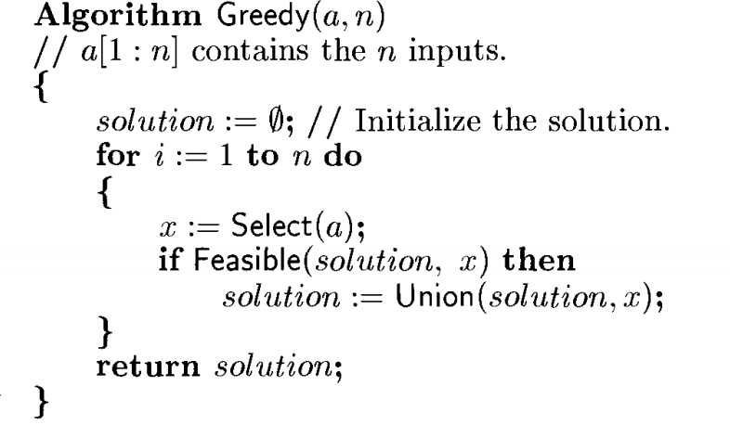
Greedy Method

Slide 11
Characteristics of greedy algorithm
Greedy algorithm makes best choice at each step of the algorithm
The choice made by a greedy algorithm depend on choices made so far
Greedy algorithm do not reconsider the decision take at previous step.
Greedy algorithms can be characterized as being 'short sighted', and also as 'non-recoverable'. They are ideal only for problems which have 'optimal substructure'

Slide 12
Applications of greedy
Job sequencing with deadline
Knapsack Problem
Minimum cost spanning tree
Huffman coding
Shortest path

Slide 13



